Slide 1
Familiarize yourself with phishing attacks

Slide 2
What is phishing?
Phishing is a form if fraudulent activity often used to steal personal information.
Some intent is to trick the recipient into installing malware on the device or into giving personal information, such as login credentials or financial information.

Slide 3
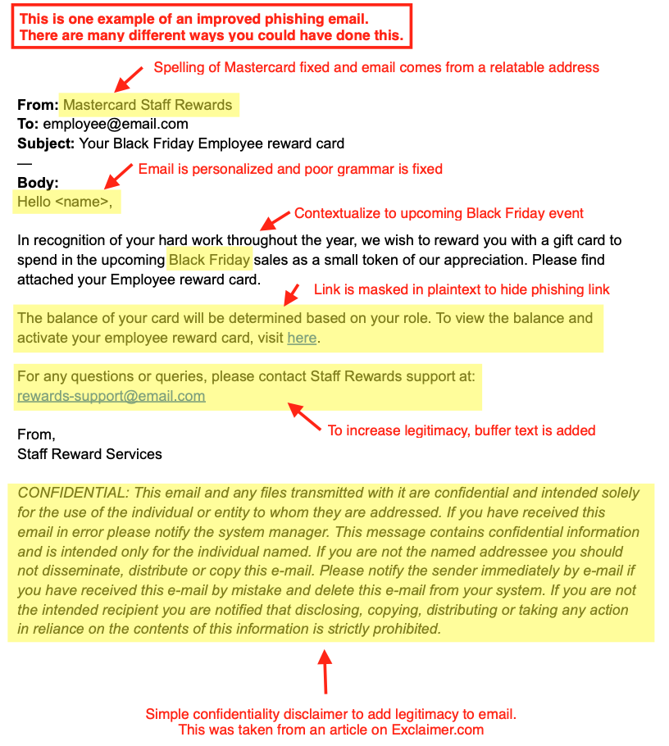
Learn to spot phishing emails
Example:

Slide 4
How do we stop getting phished?
Educating users about the dangers of unsolicitated emails and make them ware of the dangers of opening attachments.
You can become a member of the Anti-Phishing Working Group (APWG). It is an association of companies focused on eliminating identify theft and fraud from phishing.
All software should be kept up-to-date with the latest security patches applied for protection.
If the email is suspicious, you may contact the IT department for clarification.

